Slide 1
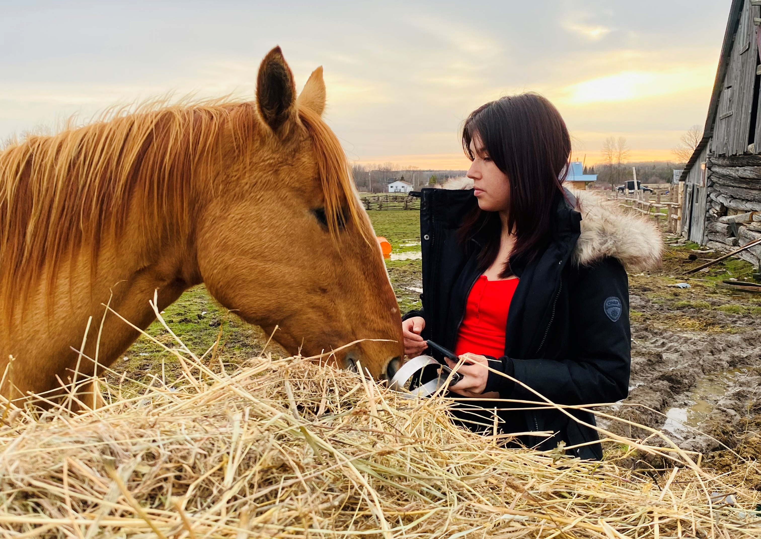
Healing with Horses
Healing Fund

Slide 2
The Healing with Horses program is helping participants reconnect, heal, and grow. With plans to expand, your generosity ensures this transformative journey continues year-round.
Notes:
When participants gather for the Healing with Horses program in Wiikwemkoong Unceded Territory, something remarkable happens. People open up. They share, listen, and connect with each other, with the land, and with the gentle strength of the horses guiding their healing journey.
Supported by your Mission and Service gifts, the program blends equine therapy with connecting culturally and wholistically to Anishnaabek ways of knowing and being. It draws on traditional knowledge, the Medicine Wheel, and the importance of relationships to support emotional, spiritual, and cultural healing. For many, these sessions are a way to work through the impacts of intergenerational trauma and journey the path toward self-discovery and confidence.
Over the winter months, participants rode through the snowy bush, sketched horses outdoors, and learned to set boundaries and practice self-compassion. Whether walking beside a horse, brushing its coat, or sitting in circle, each person found space for healing.
Participants shared that they felt calmer, more confident, and more connected. Some shared that they found it difficult to share their feelings before, but through the safety of the circle, they discovered the strength to speak and be heard.
Children learned about emotional regulation. Adults reconnected with their inner strength. Each gathering offered time to reflect, grow, and support one another. The horses, especially Cash and Willow, brought a calm and honest presence that helped participants see themselves more clearly.
There is already growing interest in expanding the program to reach more people throughout the year. Plans are underway for a barn or indoor structure that would allow healing to continue in all seasons.
Thank you for supporting the Healing Fund through Mission and Service. With your generosity, programs like Healing with Horses can continue to grow and offer life-changing opportunities for healing, connection, and cultural reconnection.

