Slide 1
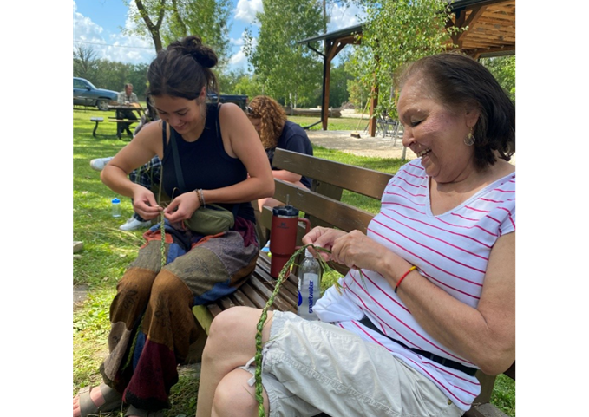
Gathering to Remember, Reconnect, and Renew
Mamawe Ota Askihk

Slide 2
Thanks to your support through the Healing Fund, the 2023 Mamawe Ota Askihk gathering created space for Indigenous cultural renewal, healing, and connection, and your generosity continues to make this sacred work possible.
Notes:
At Mamawe Ota Askihk, the land is more than a backdrop. It’s a sacred space where Indigenous children, youth, and families reconnect with culture, language, and one another.
Hosted by Sandy-Saulteaux Spiritual Centre and supported by your Mission and Service gifts, the 2023 summer gathering brought together 31 participants, supported by a team of staff, Knowledge Keepers, and youth leaders. From the first day, participants began building a community grounded in sharing, learning, and ceremony.
Workshops throughout the week included cultural teachings, hands-on skills like soapmaking and meat smoking, and powerful ceremonies, such as sweat lodges led by Knowledge Keeper Melody. Youth helped prepare medicines, served as firekeepers, and took part in every element of the lodge, deepening their understanding of tradition while finding a place of belonging.
Each evening, the group gathered around the sacred fire, where Knowledge Keeper Carla led drum songs and stories. The sound of the grandfather drum carried through the air as learning and healing wove through the circle.
The presence and engagement of the Neechi Youth Camp was central to the week’s success. These young leaders, many of whom returned in mentorship roles, participated in every activity and helped shape the program itself. Their voices, ideas, and enthusiasm brought energy and vision to the gathering. One participant reflected on how meaningful it was to feel part of something so connected: “Yes, in a way it reminds me that I am connected to people and not alone.”
The gathering was also deeply intergenerational. One participant, a Sixties Scoop survivor and niece of residential school survivors, joined with her great-niece to reconnect with culture and family. She found the experience, particularly the sweat lodge, to be profoundly healing.
There were many stories of transformation. Participants spoke of feeling safe, learning in hands-on ways that resonated deeply, and experiencing a sense of community that stayed with them long after the week ended.
Thank you for supporting the Healing Fund through Mission and Service. Your generosity makes gatherings like Mamawe Ota Askihk possible, creating space for cultural renewal, healing, and deep connection across generations.

