Slide 1
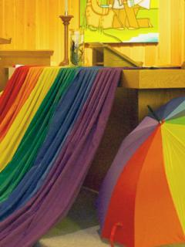
Advocating for Sexual and Gender Minorities in Other Countries
United Church of Canada

Slide 2
“This is a life and death matter.”
Notes:
We are blessed to live in Canada, a country that recognizes the right to love whoever you want, regardless of their gender or sex. And while we haven’t always done what is right, The United Church of Canada now recognizes that all love―including Two Spirit or LGBTQIA+ relationships―is holy and blessed by God. But those rights do not exist in many parts of the world today.
“One of our partners in Kenya has advocated strongly for the human rights of sexual minorities, and that has caused him to be in jail, caused him to risk his life to be able to do that,” says the Rev. Michael Blair. The church’s first openly gay General Secretary is now helping to advocate for sexual and gender minorities in foreign countries.
“When we hear these stories, we can see that this is a life and death matter.”
Your gifts for Mission and Service help shelter refugees as they escape repressive governments. As of May 2024, 64 jurisdictions criminalize private, consensual, same-sex sexual activity, and 12 countries have jurisdictions in which the death penalty is imposed or at least a possibility for private, consensual, same-sex sexual activity.
Mission and Service also holds consultations in other countries to discover how we can best work with our partners to protect sexual and gender minorities. “A few years ago, we hosted a consultation here in Canada with several partners and asked how we can be supportive of their work,” Blair says. “They told us we needed to come and help in their context.”
To date, Mission and Service has supported consultations in Latin America and the Philippines.
“We are bringing together leaders to explore how the church can be a place of liberation and life for sexual and gender minorities in those communities. That is happening because of the folks who contribute to Mission and Service,” says Blair.
Thank you for helping to protect sexual and gender minorities. You are saving lives and changing views around the world!

