Slide 1
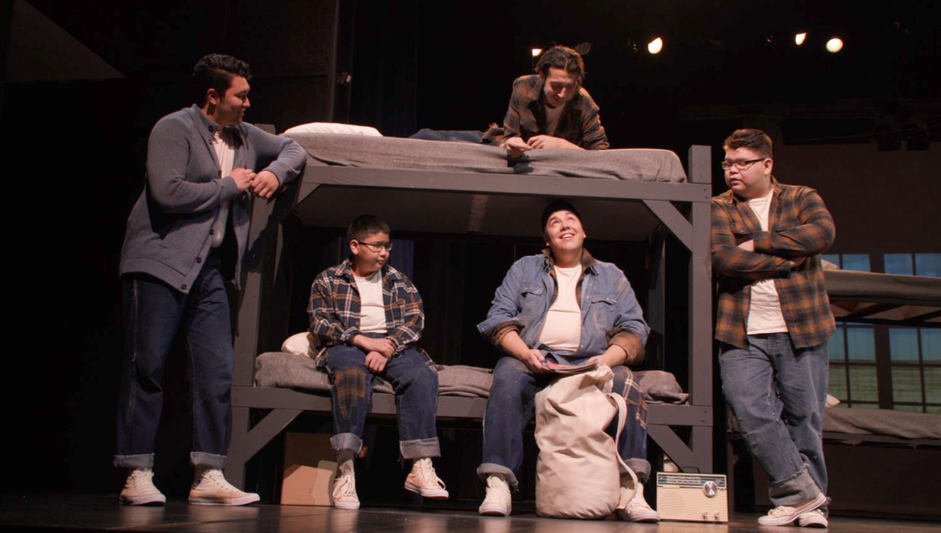
A Story of Cultural Resilience
Bunk #7

Slide 2
Storytelling has always been a powerful way to preserve history, share experiences, and shape understanding. Thank you for your continued support in keeping these important stories alive.
Notes:
Storytelling has always been a powerful way to preserve history, share experiences, and shape understanding. The theatre production Bunk #7(opens in a new tab) did just that, leaving significant impact on both the cast and the audiences who witnessed its profound narrative.
Bunk #7 tells the true story of six boys who, in the early 1960s, stood up against the systemic mistreatment and abuse they endured at Edmonton Indian Residential School in St. Albert, Alberta. Written by the late Nisga’a MLA Larry Guno, the play drew from his own experience as a student at the residential school. Bunk #7 was named after Guno’s bunk number—a personal touch that connected the story to the heart of the playwright’s lived truth.
The play was brought to life by an exceptional cast of Indigenous youth and young adults, creating a space for both performers and audiences to learn, reflect, and share the story of cultural resilience. The production premiered at Raven Theatre in British Columbia in November 2021, where it was met with overwhelming support. This response led to a transformative tour throughout northwestern BC in the fall of 2023. Each performance continued to resonate deeply with audiences, showing the lasting impact of this remarkable piece of theatre.
Bunk #7 continues to echo through the hearts of those who experienced it. The powerful message of survival, resilience, and resistance against injustice lives on, sparking important conversations and encouraging deeper understanding of the Indigenous experience.
Your gifts to Mission and Service helped create opportunities for stories like Bunk #7 to be shared, heard, and honored in a way that fosters healing and transformation. Thank you for your continued support in keeping these important stories alive.
A behind-the-scenes film(opens in a new tab), directed by Haida filmmaker Patrick Shannon of InnoNative, shares more about the people involved in bringing this powerful play to life.

