Slide 1
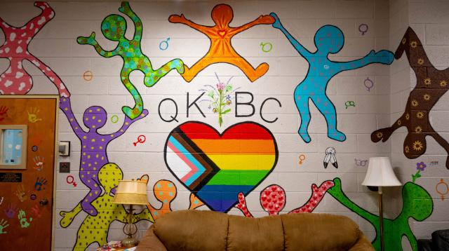
Learning About God’s Love
Silver Spire United Church

Slide 2
Young 2SLGBTQIA+ individuals explore and reconcile their faith with their identity.
Notes:
Queer Kid Bible Camp is a unique and affirming space that has emerged to provide a supportive environment for 2SLGBTQIA+ youth within the framework of spirituality. Started by Mission and Service partner Silver Spire United Church in St. Catharines, Ontario, Queer Kid Bible Camp blends teachings of God’s love with messages of inclusivity.
Queer individuals have often been marginalized or excluded in spiritual experiences, which can make them feel isolated and alienated. Queer Kid Bible Camp aims to challenge these negative experiences by fostering a sense of belonging and acceptance in a spiritual context. The camp offers a place for young 2SLGBTQIA+ individuals to explore and reconcile their faith with their identity. Through theological and spiritual discussions, youth can openly ask questions without feeling uncertain about their safety.
The benefits of Queer Kid Bible Camp extend beyond its immediate impact on individual campers. The camp experience sparks conversation with parents and guardians who want to connect and understand their children better. As young participants gain confidence and self-acceptance, they become advocates for change within their own communities. The Rev. Karen Orlandi of Silver Spire United Church has seen a wonderful ripple effect, noting that she’s seen “healing for queer adults as they see queer kids openly embracing their identity.”
Your support through Mission and Service provides the queer community with opportunities to thrive in safe environments as they learn about God’s love. Thank you.

