Slide 1
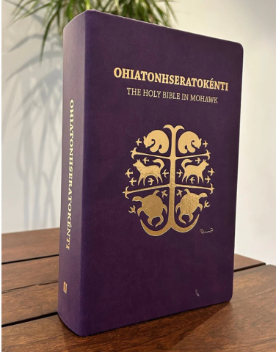
Faith in Every Word: The Mohawk Bible Translation
Ohiatonhseratokénti: The Holy Bible in Mohawk

Slide 2
Thank you for helping to uplift voices, preserve heritage, and walk in respectful relationship.
Notes:
Language carries the unique way a community understands the world. It shapes how people relate to one another, to the land, to the spiritual, and to the sacred. When a language is lost, a way of seeing the world is lost with it.
Preserving language enables future generations to engage in their rich culture in a rounded and essential way. Without understanding dialect-specific phrases and expressions, the vital wisdom of a culture can be lost.
As part of the ongoing work of preserving the Mohawk language, a complete translation of the Bible into the Mohawk language was developed, through the devotion, knowledge, and artistry of Harvey Satewas Gabriel and supported by generations of women in the Gabriel family and the communities of Kanesatake and Kahnawake.
Those partnering on the Mohawk Language Bible have taken great care and effort in ensuring proper language interpretation and translation. Working in agreement with the Mohawk Nation, collaborators have taken the time to listen to each other and learn in order to move the project forward.
Your gifts to Mission and Service allow projects that preserve language and culture to flourish. Thank you for helping to uplift voices, preserve heritage, and walk in respectful relationship.
Ohiatonhseratokénti: The Holy Bible in Mohawk is available for purchase through the UCRD bookstore.

