Slide 1
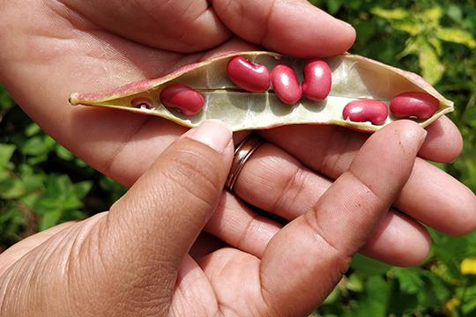
Supporting a Rights-Based Approach to Growing Food
The Association of Economic and Social Development Santa Marta (ADES)

Slide 2
The Association of Economic and Social Development Santa Marta (ADES) works closely with the community to grow food in a rural region of El Salvador.
Notes:
The Association of Economic and Social Development Santa Marta (ADES), a Mission and Service partner, is located in an area of Central America that is very vulnerable to climate change. This hot, dry region regularly experiences drought. Mining projects have also negatively affected the environment and the people in the region. ADES and other community organizations decided to act to protect the community’s right to a healthy environment.
An example of how ADES has responded is a three-year agroecology project co-funded by the Manitoba Council for International Cooperation and The United Church of Canada Foundation, along with Mission and Service. Agroecology benefits the land and water because it recycles nutrients back into the soil. It also reduces production costs, lessening the financial burden on rural farmers.
In this project, ADES works closely with the community to grow food in a rural region of El Salvador, promoting sustainable agriculture that protects biodiversity, maintains the integrity of the land, and upholds rural culture.
At the centre of the project is the Dora Alicia Sorto School Farm, where rural families, mainly led by women, learn about agroecology. The school provides training, technical expertise, and seeds indigenous to the region. It focuses on preserving the surrounding environment and on upholding gender and human rights as part of its approach to food security.
Your gifts to Mission and Service help support ADES’ agroecology project. Thank you for your generosity!

