Slide 1
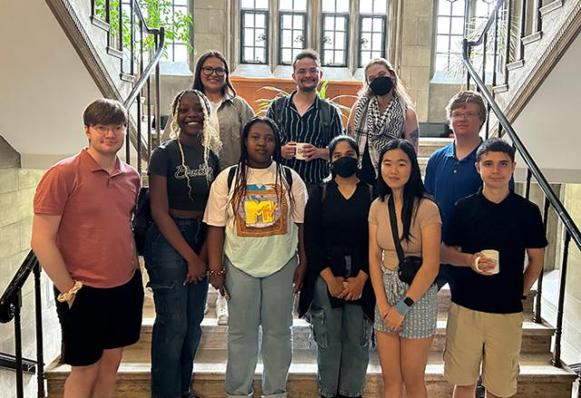
The Next Century: Youth Leading the Way
Youth Forum Leadership Animators

Slide 2
Youth Forum Leadership Animator Mariana Muhumuza envisions a diverse, open United Church in 100 years, shaped by today’s emerging leaders.
Notes:
“100 years from now, I definitely see the church being a diverse and open space for all because of the program boards and boards that are being put in place.”
These are thoughts from Mariana Muhumuza, one of The United Church of Canada’s Youth Forum Leadership Animators, on her vision for the next 100 years of the United Church of Canada. More of Mariana's thoughts on the United Church's Centennial can be found on YouTube.
In July 2024, Mariana was among eight passionate youth from across Canada who gathered in Calgary. Together, they worked to lay the foundation for 100 young people under the age of 30 to attend The United Church of Canada's General Council 45 in 2025, coinciding with the church's Centennial commemorations.
This group of talented and diverse youth is committed to developing leadership among their peers. After their time in Calgary, they returned to their local communities and regions to work on learning goals and projects for four weeks, and to remain engaged throughout the year.
The group focused on building leadership and guiding their peers as they explore their roles in the church. Their placements in local and regional communities are designed to help them grow and prepare for the future.
Your gifts to Mission and Service support youth as they inspire communities and engage in leadership. Thank you.

